Slide 1

ELL Leadership Academy
Karina E. Chapa, M.Ed.
Language Proficiency, Biliteracy
and Cultural Diversity Director
kchapa@esc1.net

Slide 2


Entry Tickets
Name: District:
Role:
Hobbies/things you like to do in your “off” time
Your favorite song (one you’d listen to over and over again)
Your biggest “pet peeve”

Slide 3
Professional Learning Essential Agreements
Be respectful of others
Be an active participant
Take care of your needs
Use electronic devices as learning tools

Slide 4

Edmodo Code: bmnrkb
Post a comment
Reply to another person’s comment
www.edmodo.com

Slide 5
Previous Learning: ELPS
Write a “Wikipedia” type definition of the ELPS that you feel clarifies their key intent, elements, and principles – in other words, a definition that could clarify thinking in your school/classroom.
Explain to a teacher new to the field what the ELPS are in terms of what s/he would be doing in the classroom – and why. The explanation should help the candidate develop a clear picture of what the ELPS look in the classroom.
Develop a metaphor, analogy, or visual symbol – even a logo – that you think represents and clarifies what’s important to understand about the ELPS key intent, elements, and principles.

Slide 6
Next Steps
Move to the area of the room assigned to your number/choice.
In that area of the room, find a partner. Share and compare your work. Then find another partner and share again.
Make sure you discuss similarities and areas of overlap.
When instructed, move into a mixed pair or trio.
In turn, share what your task was and how you responded.
Return to your home tables and identify common points.

Slide 7

Triarchic Teaching - Sternberg
Analytical
Intelligence
Practical
Intelligence
Creative
Intelligence

Slide 8
Which set of verbs appeals to you most?
Analytical
Analyze, judge, critique, compare, contrast, evaluate, diagram, identify, explain, present a step by step approach, assess.
Practical
Implement, apply, use, demonstrate, teach, put into practice, convince, show how, employ, make practical.
Creative
Invent, discover, imagine, suppose, design, predict, find a new way, create, promote, encourage, develop.

Slide 9
Session Objectives
Content Objective
Today I will analyze different accountability systems and the impact they have on the instruction of English Language Learners.
Language Objective
Today I will write and share a plan of action that covers all accountability systems to better educate all ELLs in my school/district.

Slide 10
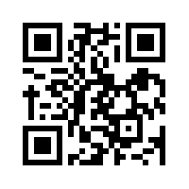
State Accountability
Anticipation Guide
kahoot.it
create.kahoot.it

Slide 11
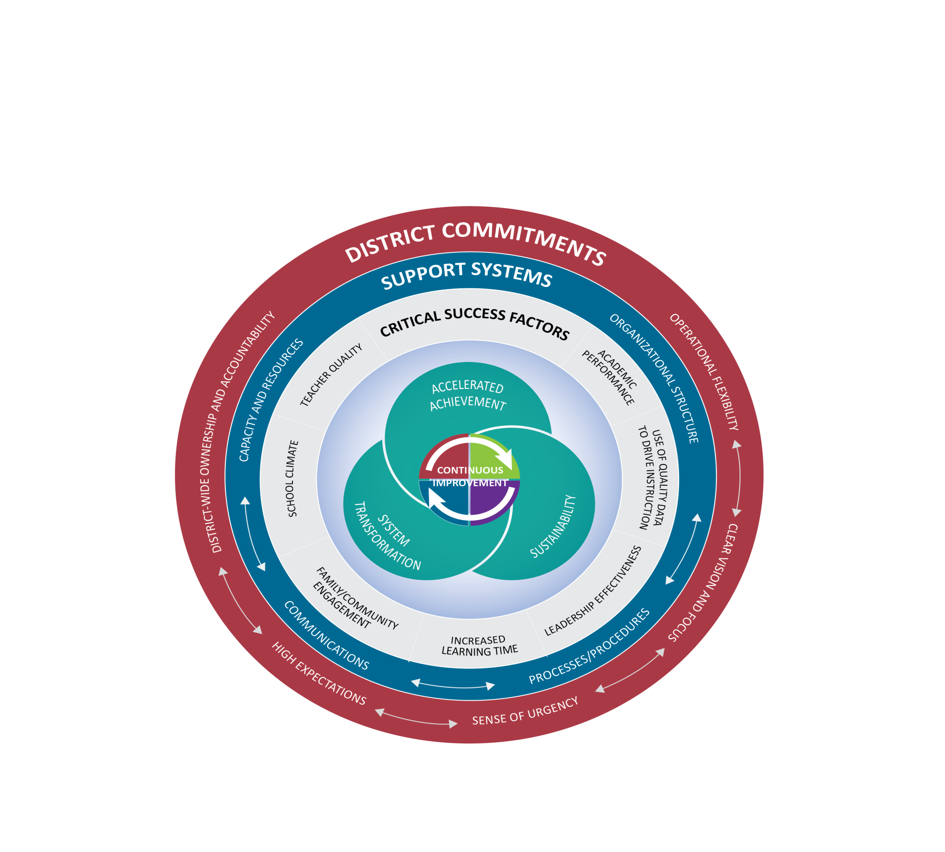
Texas Accountability Intervention System (TAIS)
Notes:
Presenter Talking Points:
The Texas Accountability Intervention System is a research based approached to school improvement that engages the district and school in the improvement process. The framework outlines five systemic components regarding district-level commitments, four support system components to be implemented at both the district and campus levels, and seven factors know to be critical to campus success. Planning for continuous improvement through the lens of these District Commitments, Support Systems and Critical Success Factors will result in the outcomes of accelerated achievement, sustainability, and system transformation.
The Framework for district and school support was developed collaboratively between the TEA and TCDSS. Local ESCs continue to develop tools and support for districts and campuses that align with framework that drives continuous improvement.
All of these elements are part of a healthy system for improvement. It takes each part of the system operating together for school success.
I have a short video to share with you that gives an overview of this framework.

Slide 12
Data
Process
Reporting
State
Districts & Campuses
IR or Met Standard
Indexes & Safeguards
Data Analysis
Needs Assessment
Targeted Improvement
Plan with
Progress Reports
Federal (ESEA Waiver)
Districts & Campuses
Priority and Focus
Safeguards
Implement & Monitor
Improvement Plan
Performance-Based Monitoring (PBM)
Districts
PBMAS
Notes:
Presenter Talking Points:
The continuous improvement process has been designed in such a way that regardless of what accountability rating initiates the engagement to the framework, the continuous improvement process is universally applicable in getting the work done in a targeted way.
Optional Activity: Before the break, give teams a couple minutes to write down or discuss 1 question they may have swirling around at this point and 1 thing that is square in their thinking.
Optional Activity: Share out could be used as a way to welcome group back from the break.

Slide 13
2016 INDEXES AND SAFEGUARDS
State and Federal Accountability Systems

Slide 14
State Accountability Videos
English: https://youtu.be/cbEgrdijuc8
Spanish: https://youtu.be/eidlyApBSkY

Slide 16
Index Framework

Slide 17
Index 1

Slide 18
Index 2

Slide 19
Index 3

Slide 20
Index 4

Slide 21
Region One ESC

Slide 22
Index 1

Slide 23
Index 1
-16%
-18%
-10%

Slide 24
Index 2
-1%

Slide 25
Index 2
-2%
+1%
-3%
+1%
-2%
+1%

Slide 26
Safeguards

Slide 27

Indexes and Safeguards Reports
https://goo.gl/HKZC94
Notes:
1hr 45 mins = 10:15 AM

Slide 28
2016 PBMAS
Performance Based Monitoring Analysis System

Slide 29
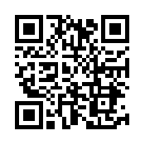
PBMAS Reports
https://goo.gl/RKDUya

Slide 30
Special Education
NCLB Title I Part A At Risk
Program Performance
&
Program Effectiveness
Bilingual ESL
NCLB Title I Part C Migrant
CTE

Slide 31
PBMAS Guiding Principles
Positive Results for Students
Annual Evaluation
Maximum Inclusion
High Standards
Indicator-Level Accountability
Statutory Requirements
Public Input and Accountability
System Evolution
Coordination

Slide 32
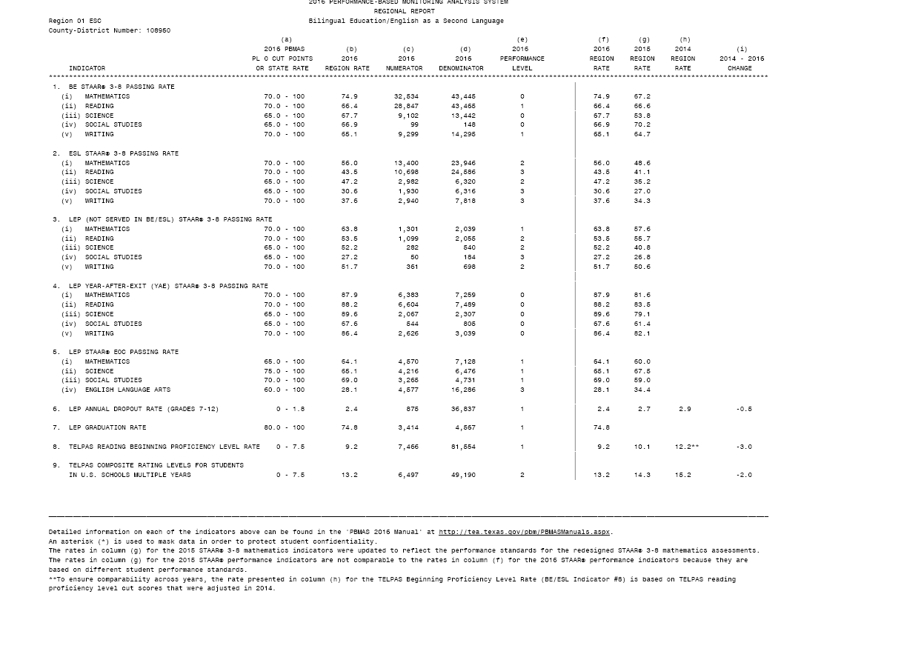
BE/ESL (Indicators 1-9)
ELLs are advancing academically as per STAAR performance
ELLs Not Served in BE or ESL are advancing academically as per STAAR performance
ELLs are graduating and not dropping out of school
ELLs grades 2-12 are not scoring beginning proficiency level for two consecutive years on TELPAS Reading
ELLs grades 5-12, 5 + years demonstrate progress on TELPAS Composite rating and are not continuing to be rated B or I

Slide 34
Bilingual/ESL
BE/ESL Indicators #1 (BE) - #2 (ESL)
Students participating in Bilingual (#1) or ESL (#2) programs.
STAAR, STAAR Spanish, STAAR A, and STAAR Alternate 2
Mathematics (3-8), Reading (3-8), Science (5,8), Social studies (8), and Writing (4,7).
Students assessed with STAAR Alternate 2 are included in the numerator if they achieve the final Level II performance or higher.
For mathematics, any prior year data used in aggregation and required improvement calculations were updated to reflect the performance standards for the redesigned STAAR 3-8 mathematics assessments.

Slide 35
Bilingual/ESL
BE/ESL Indicator #3 (Denials)
ELL students NOT participating in Bilingual or ESL programs.
STAAR, STAAR Spanish, STAAR A, and STAAR Alternate 2
Mathematics (3-8), Reading (3-8), Science (5,8), Social studies (8), and Writing (4,7).
Students assessed with STAAR Alternate 2 are included in the numerator if they achieve the final Level II performance or higher.
For mathematics, any prior year data used in aggregation and required improvement calculations were updated to reflect the performance standards for the redesigned STAAR 3-8 mathematics assessments.

Slide 36
Bilingual/ESL
BE/ESL Indicator #4 (Year After Exit)
Monitored Year 1 students.
STAAR, STAAR Spanish, STAAR A, and STAAR Alternate 2
Mathematics (3-8), Reading (3-8), Science (5,8), Social studies (8), and Writing (4,7).
Students assessed with STAAR Alternate 2 are included in the numerator if they achieve the final Level II performance or higher.
For mathematics, any prior year data used in aggregation and required improvement calculations were updated to reflect the performance standards for the redesigned STAAR 3-8 mathematics assessments.

Slide 37
Bilingual/ESL
BE/ESL Indicator #5: EOC
Current ELL students taking EOCs.
The LEP STAAR EOC passing rate is based on STAAR, STAAR A, and STAAR Alternate 2 results from the following EOC assessments as applicable: mathematics (Algebra I), science (Biology), social studies (U.S. History), and English language arts (English I and II).
Students assessed with STAAR Alternate 2 EOC are included in the numerator if they achieve the final Level II performance or higher.
New! Performance levels will be assigned for BE/ESL #5(iv) (English language arts). For this indicator, only one year of data is available for analysis, and required improvement is not available.

Slide 38
Bilingual/ESL
BE/ESL Indicator #6: LEP Drop-Out
Dropout data are for the 2014-2015 school year and are the most current data available for use in the 2016 PBMAS.
PL 0 = 0% -1.8%
PL 1 = 1.9% - 3.3%
PL 2 = 3.4% - 5.3%
PL 3 = 5.4% - 100%

Slide 39
Bilingual/ESL
BE/ESL Indicator #7: LEP Graduation
Graduation data are for the class of 2015 and are the most current data available for use in the 2016 PBMAS.
New! This indicator is based on students reported in PEIMS as LEP at any time while attending Grades 9-12 in a Texas Public School.
PL 0 = 80% - 100%
PL 1 = 70% - 79.9%
PL 2 = 55% - 69.9%
PL 3 = 0% - 54.9%

Slide 40
Bilingual/ESL
BE/ESL Indicator #8: TELPAS Reading
Number of ELLs in Grades 2-12 who scored BEG on TELPAS Reading in 2016
Number of ELLs in Grades 2-12 who tested on TELPAS Reading in 2016 & 2015
PL 0 = 0% -7.5%
PL 1 = 7.6% - 10.9%
PL 2 = 11% - 13.9%
PL 3 = 14% - 100%

Slide 41
Bilingual/ESL
BE/ESL Indicator #9: TELPAS Composite
Number of ELLs in Grades 5-12 (5+ Yrs) with TELPAS Composite BEG or INT
(who did not meet STAAR/EOC English satisfactory academic performance)
Number of ELLs in Grades 5-12 (5+ Yrs) with a TELPAS Composite rating
PL 0 = 0% -7.5%
PL 1 = 7.6% - 10.5%
PL 2 = 10.6% - 14.4%
PL 3 = 14.5% - 100%

Slide 43
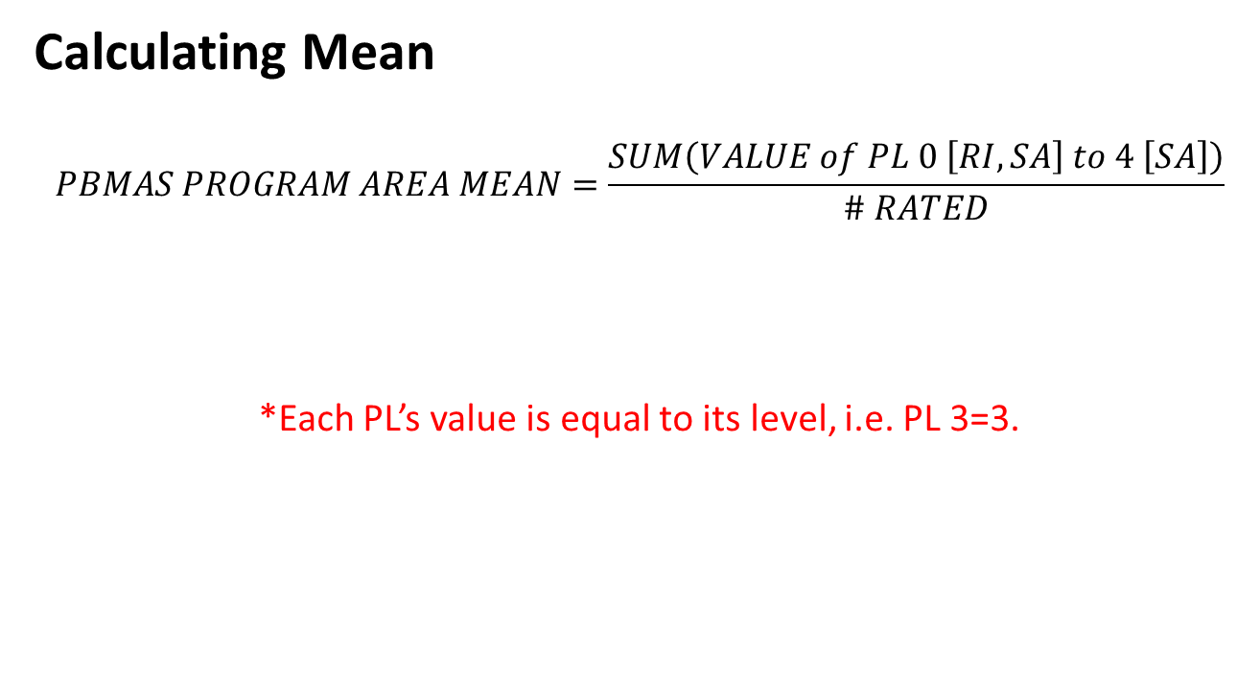
2016-2017 Staging Framework

Slide 44
2016-2017 Staging Framework
Mean Ranges by Program Area for a 90%/10% Distribution
STAGE | BE/ESL | CTE | TITLE | SPED
1 | 0.2 – 1.0 | 0.2 – 0.8 | 0.2 – 0.9 | 0.2 – 1.3
2 | 1.1 – 1.6 | 0.9 – 1.1 | 1.0 – 1.5 | 1.4 – 1.5
3 | 1.7 – 1.9 | 1.2 – 1.4 | 1.6 – 2.2 | 1.6 – 1.8
4 | 2.0 – 3.0 | 1.5 – 2.1 | 2.3 – 3.0 | 1.9 – 2.2

Slide 45
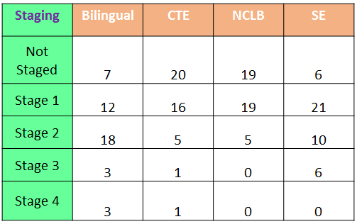
Region One 2016 PBMAS Staging

Slide 46
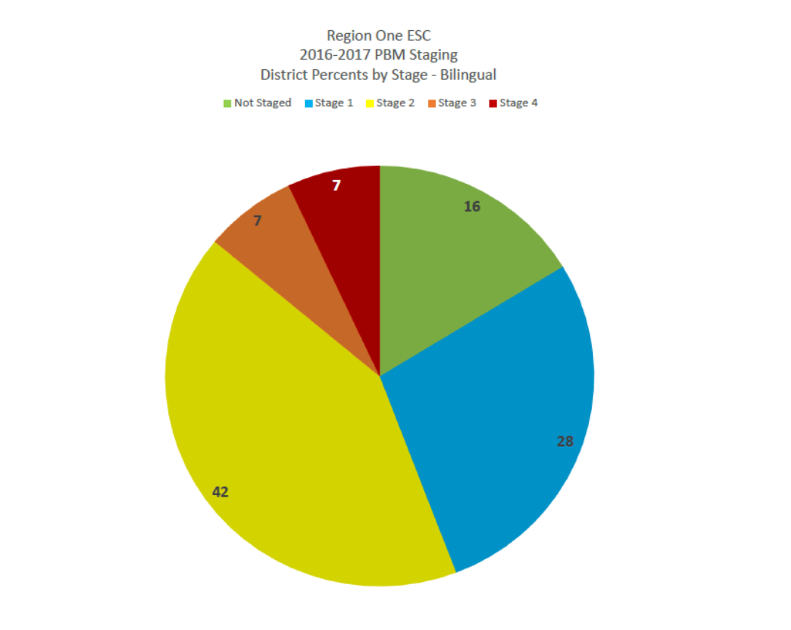
Notes:
11:15 AM

